Slide 1
AirBnb Data ANALYSIS
Understanding the price trend of the AirBnB data
- Priyam Sinharoy

Slide 2
Introduction
Provide insights into the patterns of AirBnB price data and applying the machine learning models to predict the price.

Slide 3
Modification in the data set
Checking null Values
Checking of Duplicate Values
Treating the outliers of the data
Data imputation

Slide 4
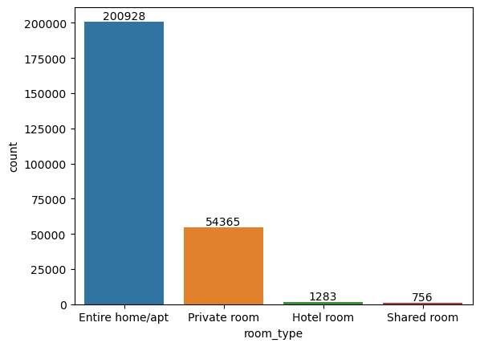
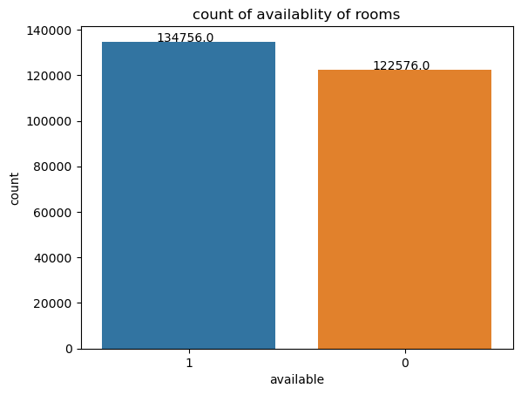
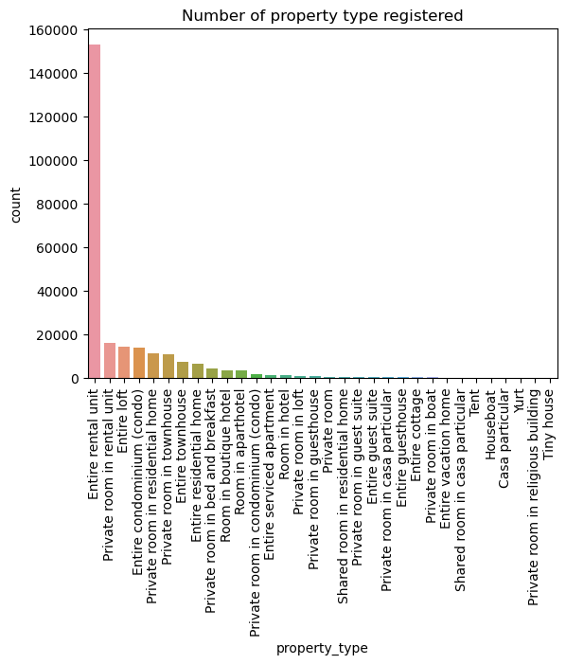
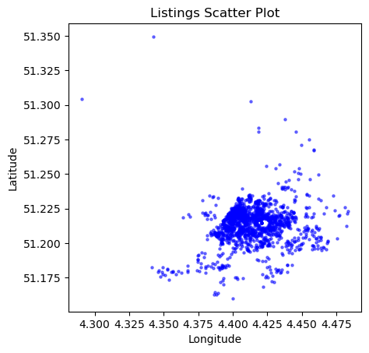
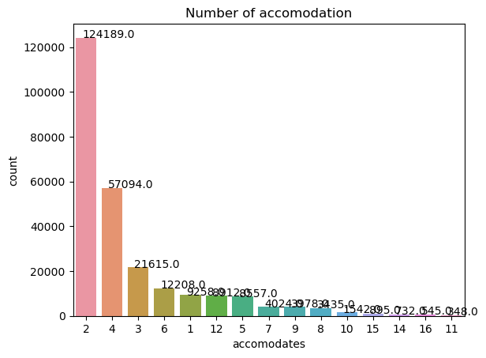
Univariate Analysis

Slide 5
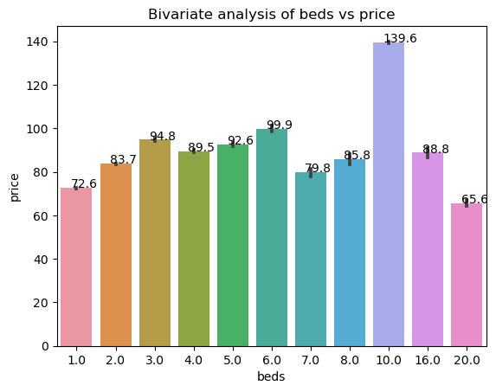
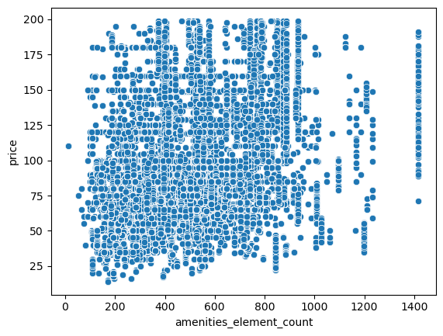
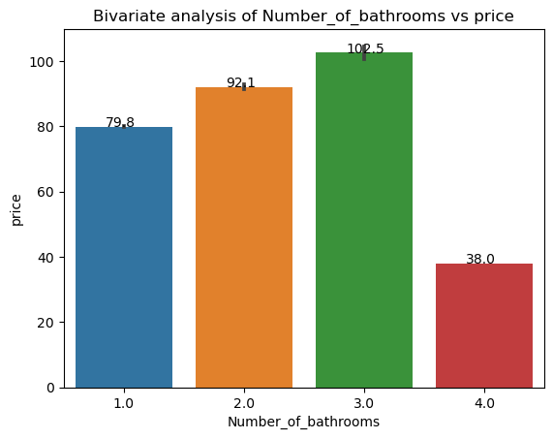
Bi-variate Analysis

Slide 6
Model Application
Linear Regression
Decision Trees regression
Random forest
Gradient Boosting Method

Slide 7
Feature Selection
Select-K-Best
Feature importance using ExtraTreesClassifier

Slide 8
Model to be selected for price Prediction

